Slide 1
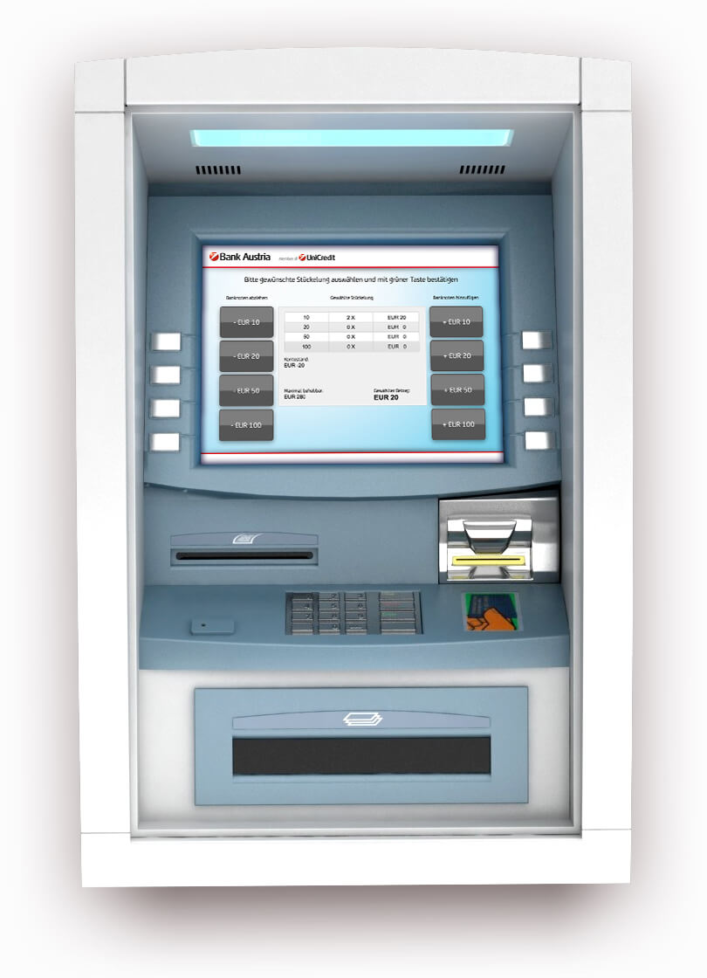
Atm Interface
By: Saikiran Pagadala

Slide 2
Languages Used
Java
MySQL

Slide 3



Software required
MySQL for Database
Eclipse for Java

Slide 4

Synopsis
Deposit
Withdrawal
Transfer
Mini statement
Custom Statement
Check balance
Pin change

Slide 5


Bankusers Table
This table contains all the users of bank.
This table has 5 columns they are user_id, firsname, lastname, balance, pin
In this, user_id is the primary key, firstname, lastname and pin columns have check conditions

Slide 6


Ministatement
The mini statement table has all the transaction history of bank users.
Table stores the transactions happened on a bank user with a user id, transaction name, amount, references and the timestamp.
This stores only those who are present in the bankusers table.

Slide 7

Database Used
The tables are created in a separate database
In this project I have created a database as “My_database”

Slide 8

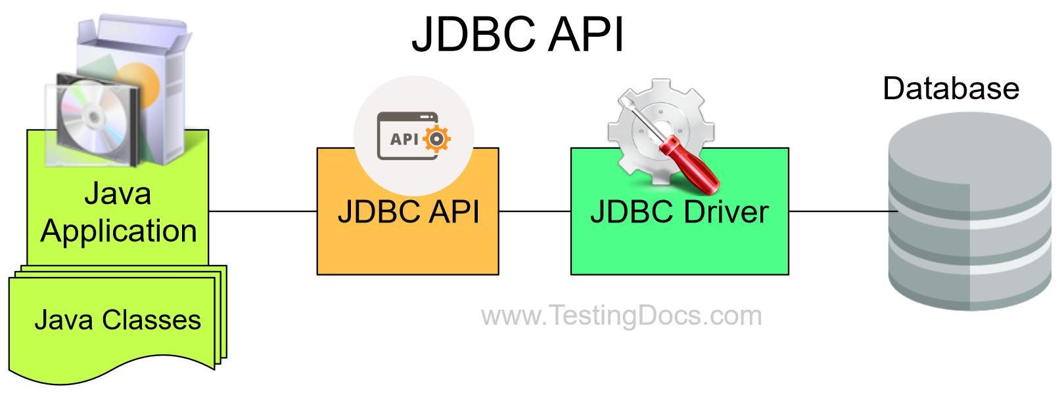
Eclipse
I have created a java project and used MySQL connector jar file.
That jar file function is to make java code and database connected.
Through jdbc we manipulate the data in the database

Slide 9

Eclipse – Classes Created
MainMenu
DatabaseConnection
Banking

Slide 10

DatabaseConnection.class
It is used to connect all the created classes to the database.
It returns a connection object which is used by every method in every class which need database connection.

Slide 11
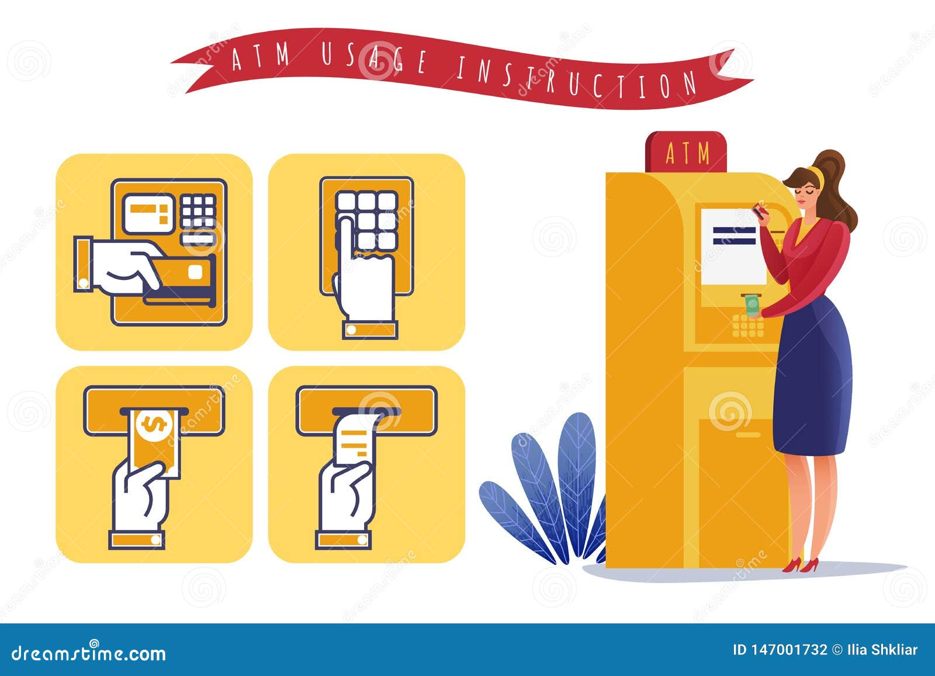
MainMenu.class
This class contains a menu of all the operations the project has.
Whenever user enters a valid id
It shows all the Eight operations as a menu list in switch case.

Slide 12
Banking.class
Deposit
Pin change
Withdraw
Transfer
Check balance
Mini statement
Custom statement
These are methods in this class.
Each has a specific function.
Whenever function completes it return to the Mainmenu class.
Process exits until user selects exit method.

Slide 13

Conclusion:
The project has implemented jdbc connectivity to
build this Atm Interface application

